Slide 1
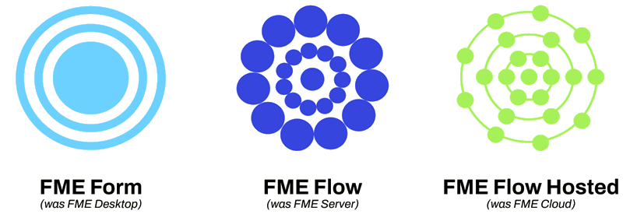
GIS – More Than Just a Job
My Journey into GIS
Notes:
Good Evening Everyone,
My name is Nick and I am an Environmental Officer and GIS Officer for Anglo Gold Ashanti.
Before I get stuck in I would like to highlight that my presentation style may seem different to others as I am adhd and high functioning autistic. I may not make eye contact, I may go off on wild tangents and sometimes I say things before my head has time to think about what im saying, which can lead to some unhinged comments. I like to highlight this as there is still a stigma around neurodiversity and by being open about it, I hope to normalizes it. I also raise It because it does tie into my GIS journey and is probably the reason, I am here talking to you today.
When John first reached out to me to see if I would be interested in presenting, we came up with the title Thrown in the Deep end. However, although true, I have changed the title to ‘More than just a job’ as I think it rings truer to my story. Over the course of this presentation, I am going to discuss what has happened to me in my first year of mapping.

Slide 2
Where it all started
Notes:
I started with AGAA 2.5 years ago. At this point I had no GIS training and no exposure to any spatial software (bar one uni unit that I cant remember). About a year into my time with AGAA I started to undertake ground disturbance permits and exploration investigation notifications. I was keen to learn about these processes and all was going well until I found out it came with what I believe to be the worst type of torture (press next) … Mapinfo. This software is in my opinion … horrible, and I wasn’t shy about trying to hide my hatred. So I downloaded QGIS and started to just do my own thing.
It was at this point that my manager Rose had observed that when I was doing GIS work I was calm, focused, quiet and engaged (the complete opposite to how I usually am). I didn’t notice this at the time but looking back now I can see that GIS tasks had become a source of hyperfixation for me. It was a way to stop my head from overloading with balancing my normal daily work tasks, my adhd wanting to be spontaneous and extraverted and my autism wanting me to be methodical and introverted. For those who have those conditions you will know what I mean when I say that at the end of the day you are drained. GIS manages to stop me from feeling drained.
It was around this time that the GIS team was being revamped and one of the tasks on their list was to review the software packages. Its also happened that one of the team members was stepping away on mat leave so Anglo was externally hunting for a GIS cover person. Rose reached out the GIS Team leader and said do you think we could second Nick into the role. And so it began…

Slide 3
The Golden Dawn - QGIS
Although having played with QGIS at work and undertaking the Mammoth Geospatial intro to QGIS course most of my development was self taught.
Simple to use – and as a free software it has so much online information if you are stuck with a particular task.
Free - we saved a lot of money moving from Mapinfo to QGIS.
Compatible - Easy to connect to SQL and Mergin Maps and to generate TIFF files for use in Avenza.
Complex – I'm always finding new tools or methods to complete tasks.
Adaptable – unlike other softwares which I find to have very little development the number of plugins available and frequent updates to the software for is amazing.
Notes:
Qgis for me changed the game

Slide 4
MAPSWA
Mapping and Planning Support WA, also known as MAPSWA was started in 2012 after the Margaret River/Roleystone bushfires. We operate as a Volunteer Fire and Emergency Service (VFES) under the Department of Fire and Emergency Services in Western Australia. Our mission is to manage and train geospatial volunteers for deployment during bushfires and other natural hazards in Western Australia. In recent years we have deployed mappers to signficant incidents including the 2015 Esperance bushfire, 2016 Waroona-Yarloop bushfire, 2019 Esperance complex bushfires, 2021 tropical cyclone Seroja, 2021 Wooroloo (Perth hills) bushfire and 2023 tropical cyclone Ellie. We also provide support to the State Operations Center at DFES, Cockburn.
Notes:
I used to be a volunteer bush fire fighter in two rocks but after moving to south perth, I had to give up my role. I really loved my time volunteering for them and was looking for some other group to give my time too and that is when I found MAPSWA.
MAPSWA is a Volunteer Fire and Emergency Service group linked to DFES. The group has spatial professionals who dedicate some of their time to supporting the volunteer groups and emergency service professionals with bushfires, land searches, flooding, cyclones etc.
This was an awesome group to find as it meant that I could keep up all my training with DFES current and also stay involved with the emergency service groups.
I am new to the group and still undertaking my training but I am looking forward to getting stuck in this year.
Now before I move onto my next topic Im going to show you an odd stat but stay with me as it leads somewhere.

Slide 5
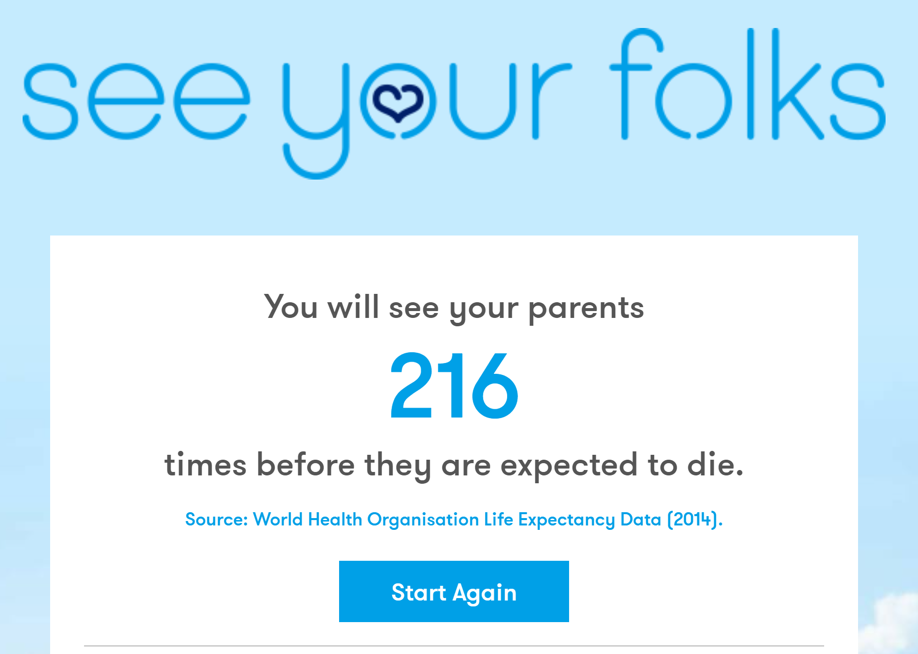
Notes:
See your folks is a group who use life expectancy data to show you how many times you will see your parents. The number on screen is based on the ages of both my parents, when I moved out and how many times I would have seen them a year.
6570 days is the total for 0-18 years
Now I didn’t like this statistic and thought I would do something about it. Que…

Slide 6
WANOSCG
Seeyourfolks.com
Established in 1974, WANOSCG and its Members have been enjoying Western Australian native orchids for over 45 years – by promoting the study and conservation of these unique and wonderful flora.
We are a group of people from diverse backgrounds who share the love of Western Australia’s native orchids and their outstanding diversity.
In addition to gaining satisfaction and increased knowledge from the study of these fascinating plants in their natural environment, we aim to promote interest in their conservation for the benefit of future generations.
Notes:
WANOSCG - my mum and dad have both semi retired and in doing so they looked for new sources of enjoyment to put their time too. They both loved the outdoors and found WANOSCG (a DBCA affiliated group) who are orchid enthusiasts who like to research, document, protect and conserve the WA native orchids.
Mum and dad soon realized after joining the group that most members are on the older side and didn’t use much technology for their surveys. So dad reached out to see if there was anything I could set them up with. To begin with this involved mostly avenza maps of the target areas as they could mark their routes and add points for any species they found.
I went along on a couple of occasions and got hooked. So now I had to find even better ways to help the group.

Slide 7
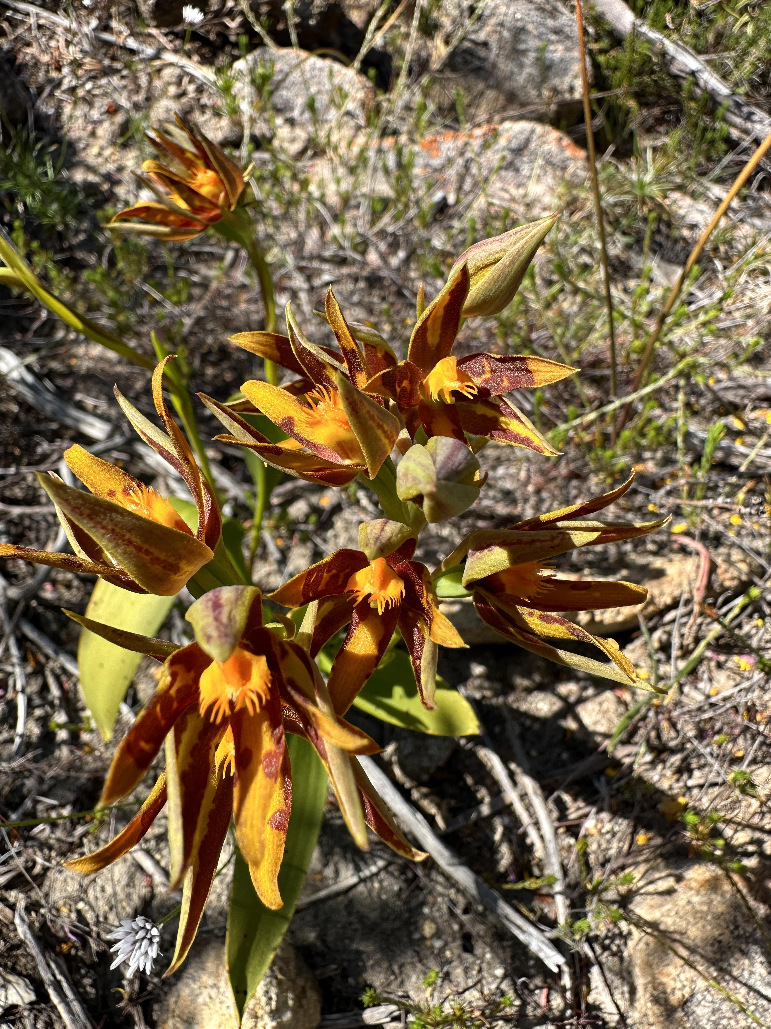
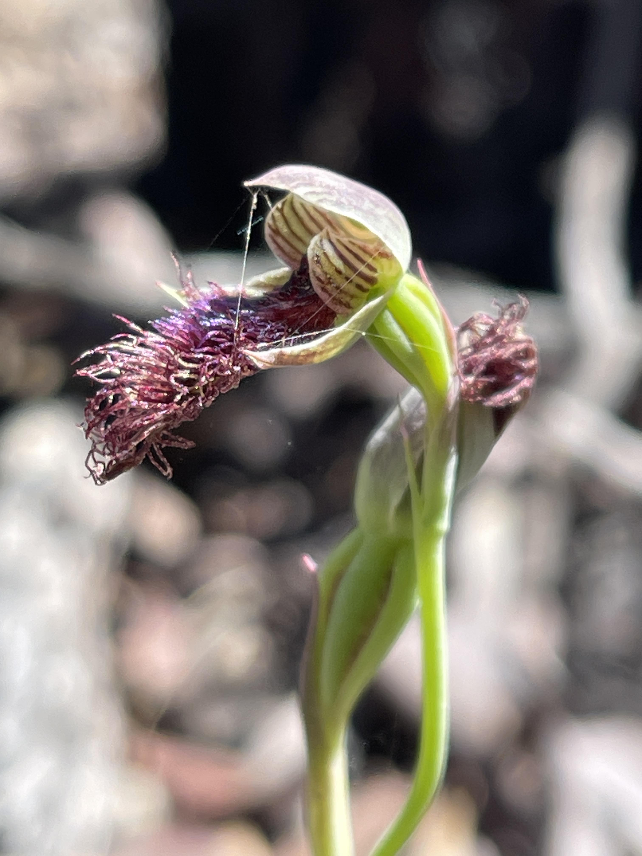
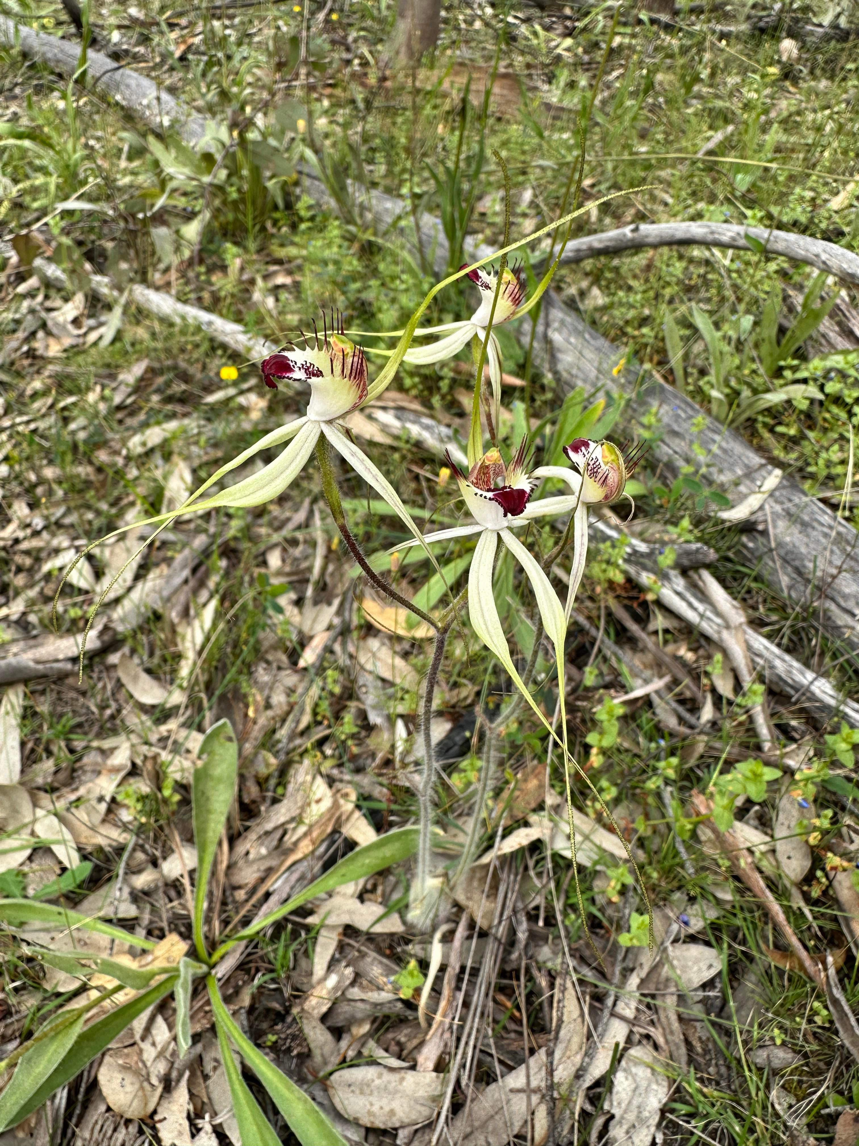
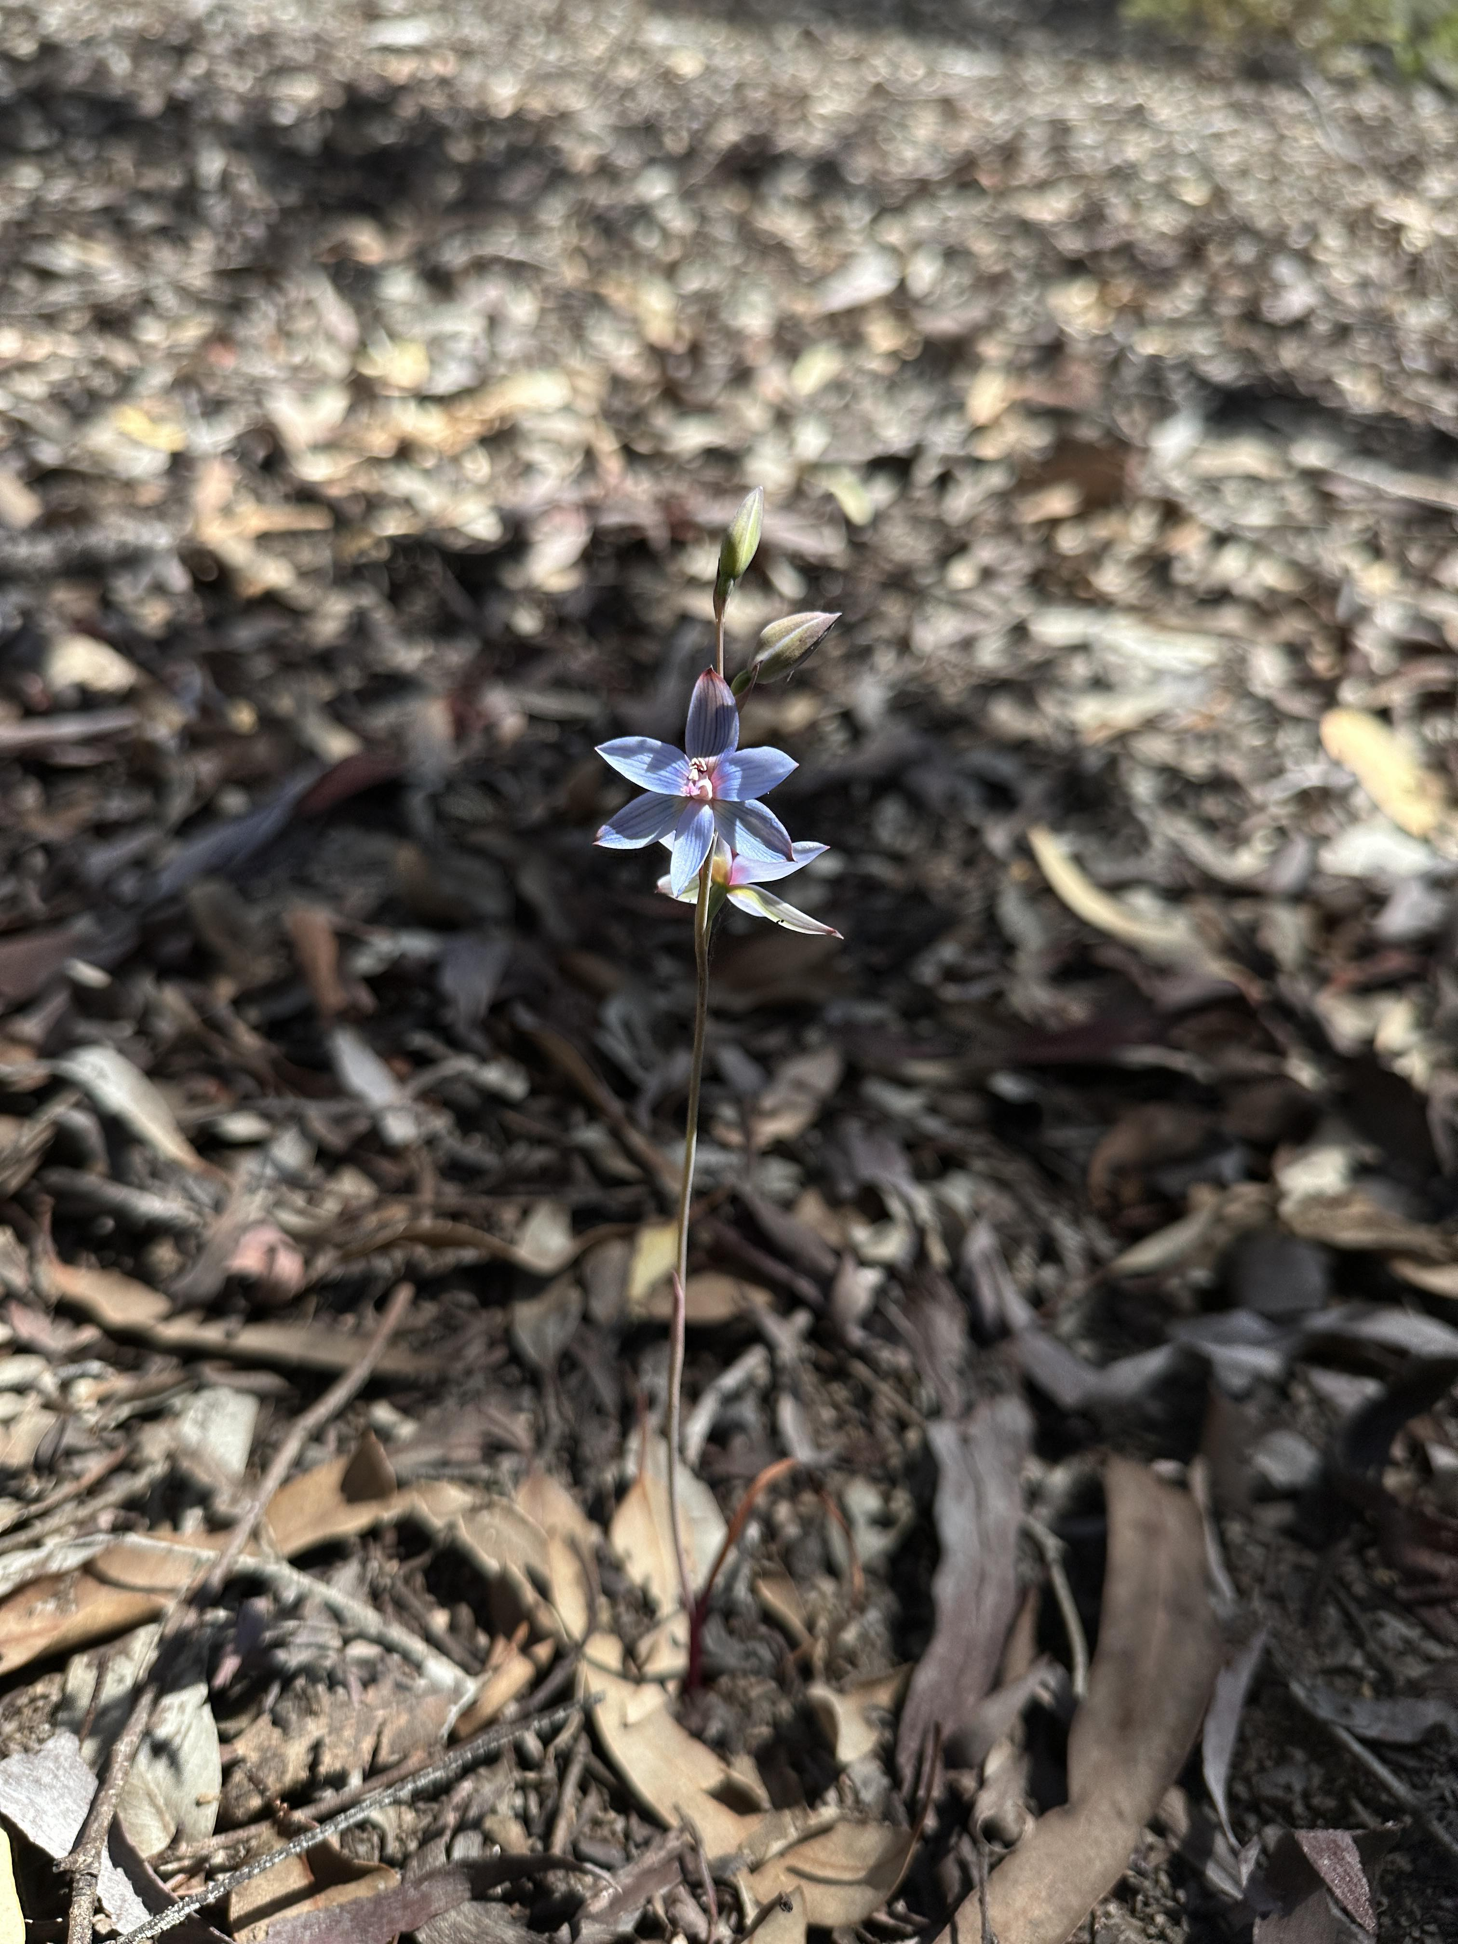
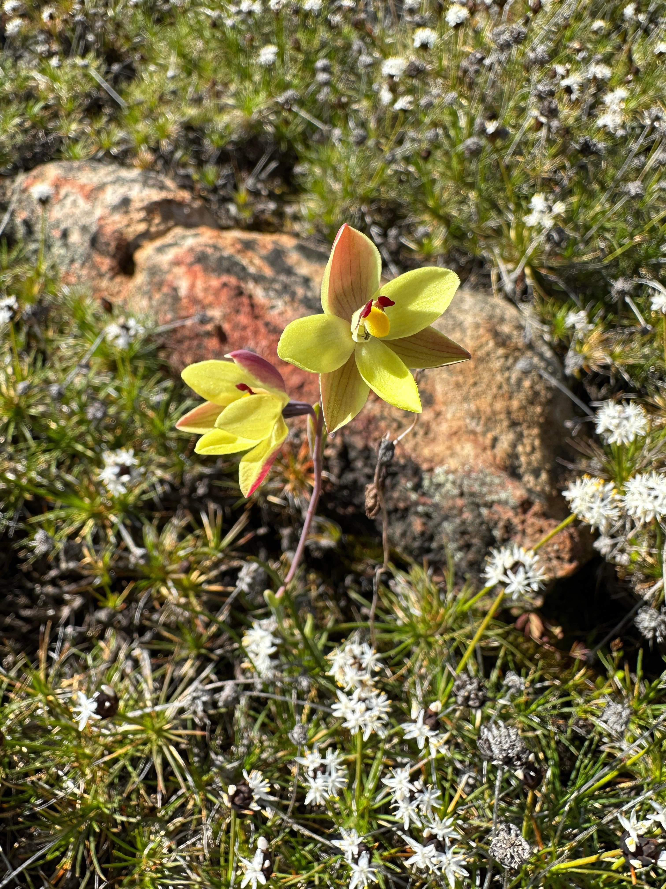
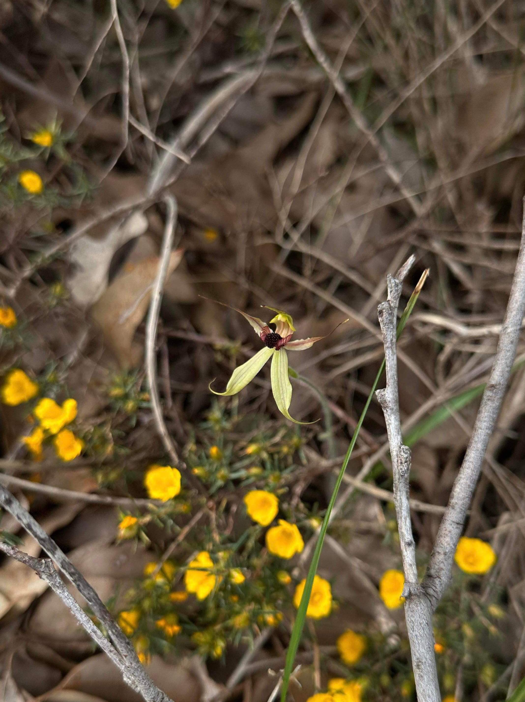
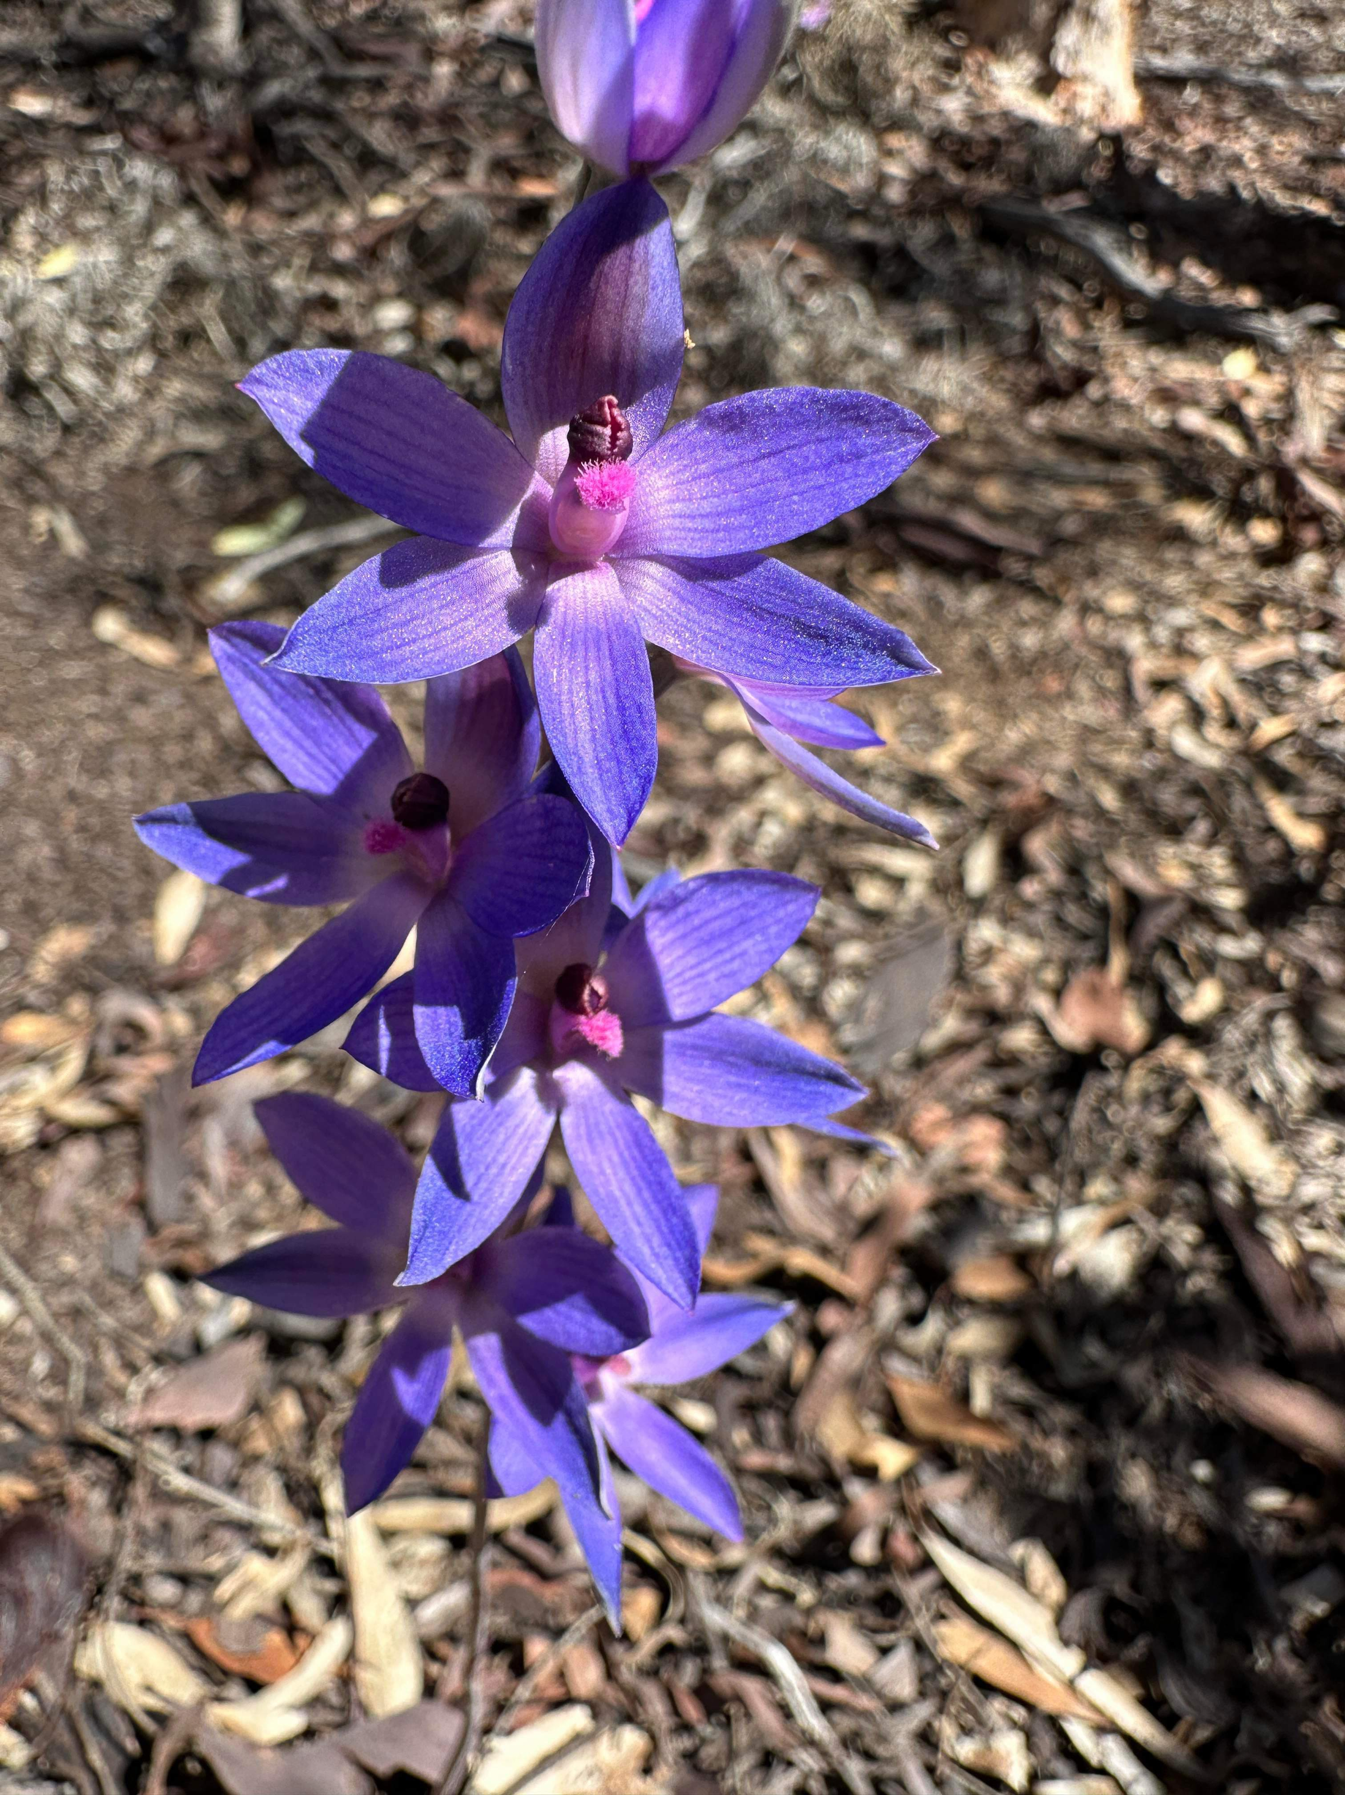
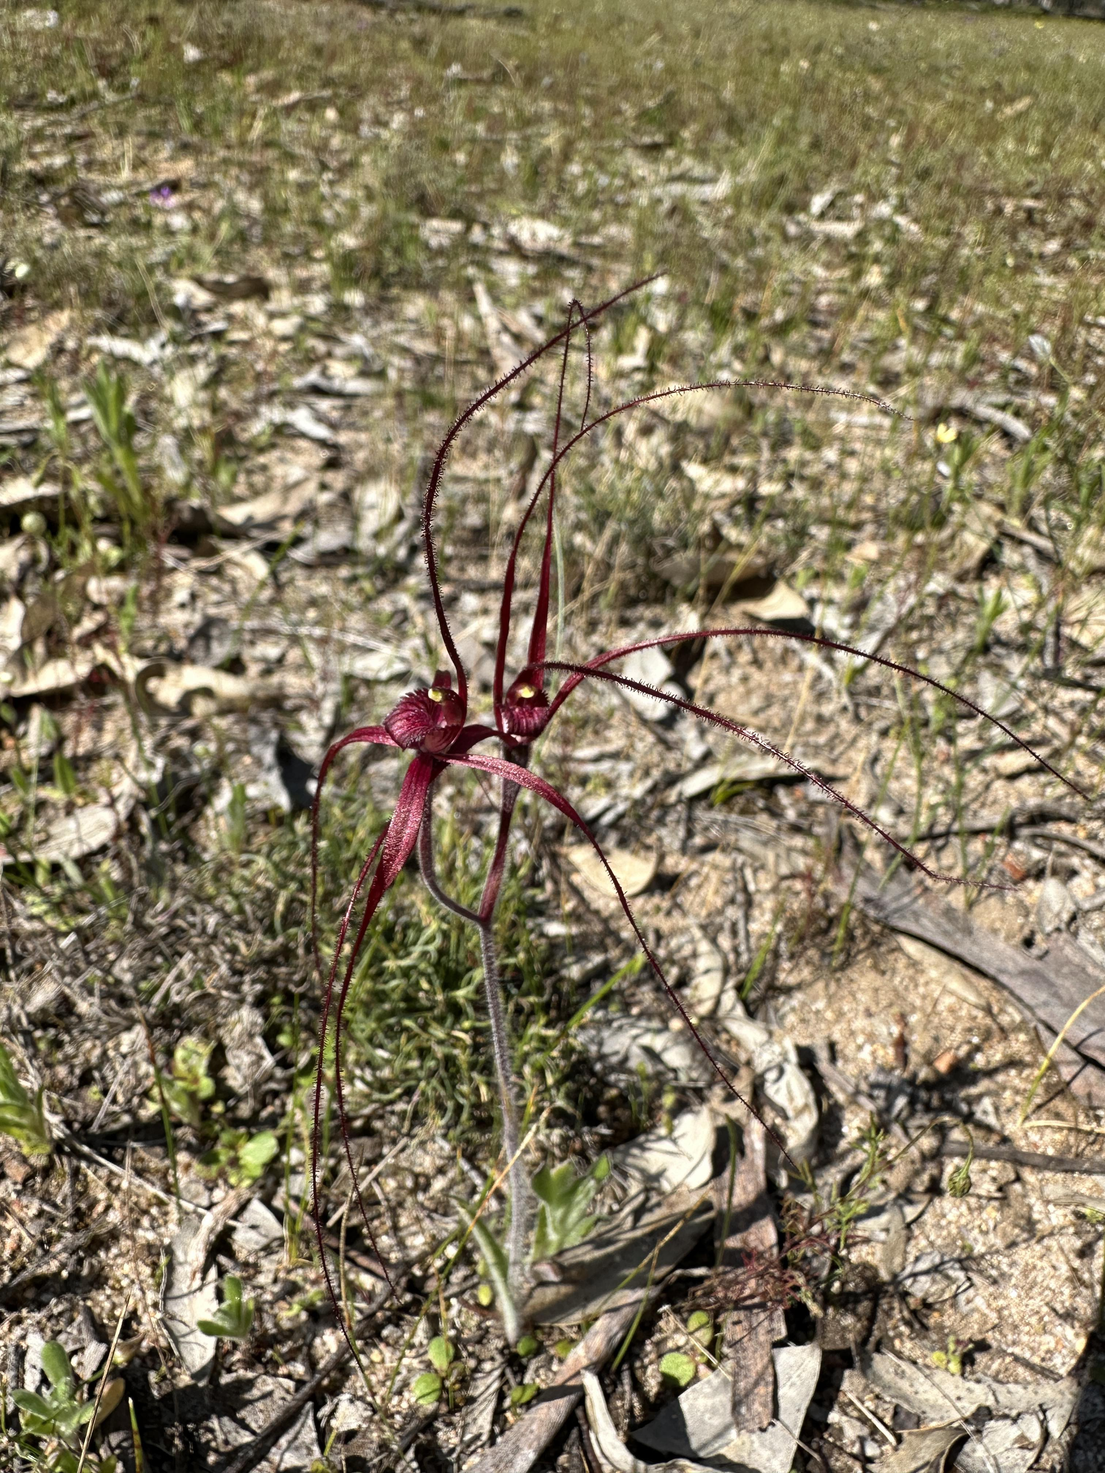
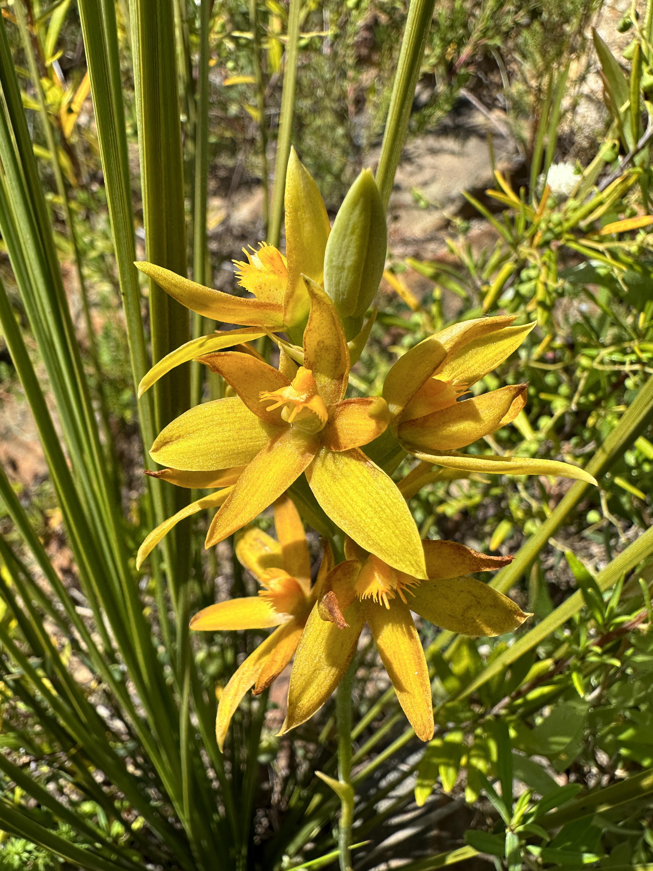
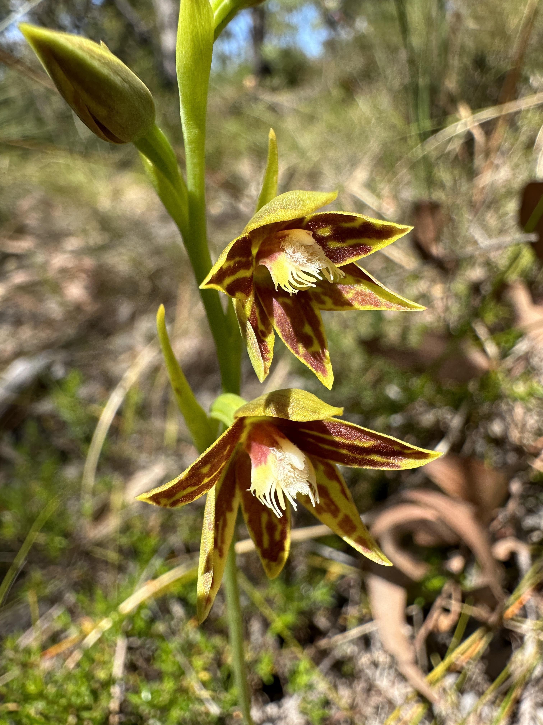

Slide 8
Mergin Maps
Direct sync into QGIS
Tracking of users in the field
Low subscription costs
Incredibly easy to customise
Able to handle multiple forms of data
Easy to search for specific attributes
Allows for changes to be made in the field which previously we were having to do manually when we got back to QGIS
Allows access to all backups (depending on subscription package) so data can be retrieved if errors are made.
Notes:
This brings me to my favorite app of the last year … Mergin Maps
This app has been a game changer both at work and for our Orchid hunting. It is incredible flexible and easy to use.
Free rant about the app

Slide 9
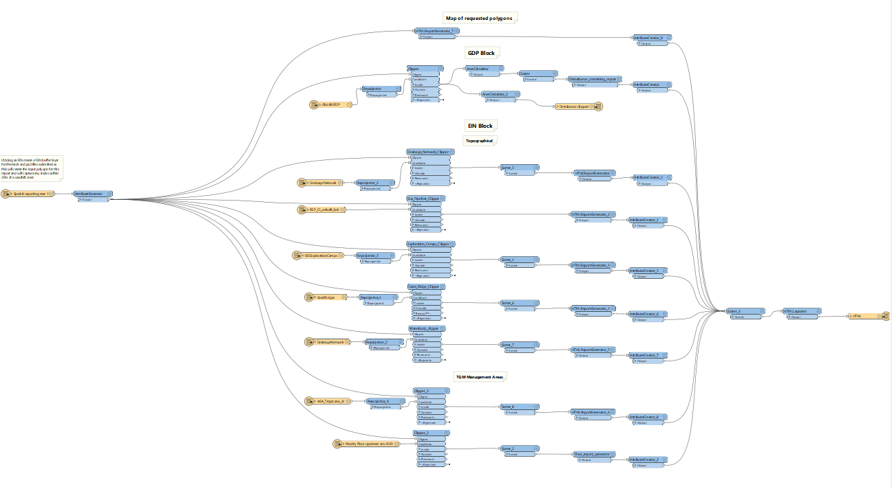
FME
Notes:
My most recent side quest took me into the wonderful world of FME. Now I have never used FME but I was getting fed up with the manual process of undertaking GDPs and EINS. So I started playing around with FME to see what is could do. The answer was a lot.
I managed to create a HTML report which provided us with all of the spatial information for features inside proposed clearing areas. The workspace above is about 1/3rd the size of the final product but it was too hard to fit on screen. Unfortunately I cant show you my final output as they are property of anglo.
This process used to involve turning on and off each individual layer and writing down what features fell inside the requested clearing/program boundaries.
Now it takes around 5 minutes to have a full report

Slide 10
Future Aims
All in all I think it was a successful first year and although my time on secondment is coming to a close, I really don’t want to lose my spatial touch. As such I'm aiming to find a GIS related side job for whilst im on my R&R.
I am hoping to gain further training/understanding in web map generation and remote sensing.
I hope to increase my knowledge and use of a greater range of spatial softwares.

Slide 11
Closing Items
Notes:
To finish my presentation, I made a promise to a close friend of mine a few years ago that whenever I got the chance to present to a group, I would always finish the presentation with a page around mental health as it effects a lot of people. This shouldn’t only be raised on a single day but should be something we always talk about. We have a group here with a shared interest so making a connection should be easier for us.
My last non GIS task to you is when the presentations are over pick someone you haven’t spoken to before from the group as you may just make a new friend.
I hope you have enjoyed my presentation

